Slide 1
Capturing Variability in Space and Time
with Hyper Feature Models
Christoph Seidl
Ina Schaefer
Uwe Aßmann

Slide 2
Agenda
Background
Software Ecosystems (SECOs) and Variability
Formalization of Feature Models
Problem: No Variability in Time in Feature Models
Contributions
Hyper Feature Models (HFMs)
Version-Aware Constraint Language
Automatic Version Selection
Conclusion: Capturing Variability in Space and Time with HFMs

Slide 3
Background
Software Ecosystems (SECOs)
Family of closely related software systems
E.g., Eclipse, Android, ROS etc.
Similar to SPLs, but…
Multiple contributors
Frequent (unsynchronized) evolution of variable assets
Variability in Space
Configuration
Variant of system
Variability in Time
Evolution
Version of system

Slide 4
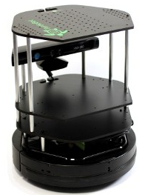
Running Example: TurtleBot Driver
TurtleBot
Engine
Movement
Webservice
Detection
[1..1]
[1..3]
Keyboard
Gamepad
Autonomous
Bump
Infrared
Ultrasound
Cross-Tree Constraints
Autonomous → Detection
Keyboard ∨ Gamepad → Webservice

Slide 5
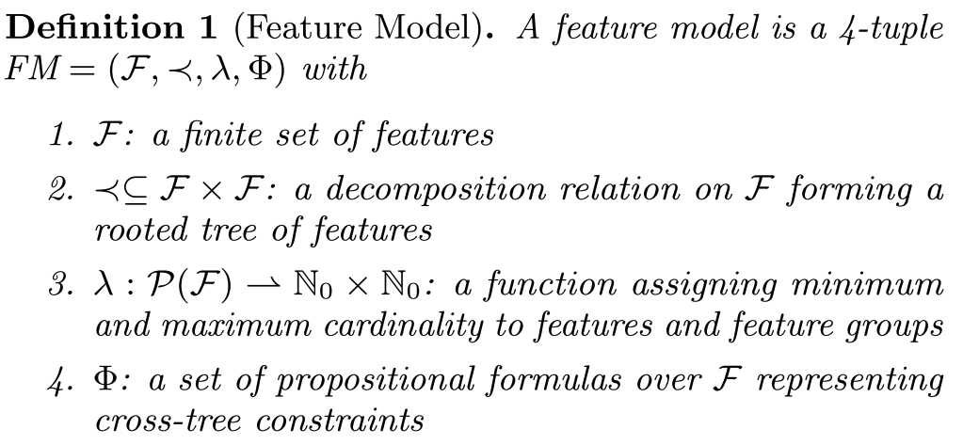
Definition 1: Feature Model
TurtleBot
[1..1]
[0..1]
Engine
Movement
Webservice
Detection
[1..1]
[1..3]
Keyboard
Gamepad
Autonomous
Bump
Infrared
Ultrasound
Cross-Tree Constraints
Autonomous → Detection
Keyboard ∨ Gamepad → Webservice

Slide 6
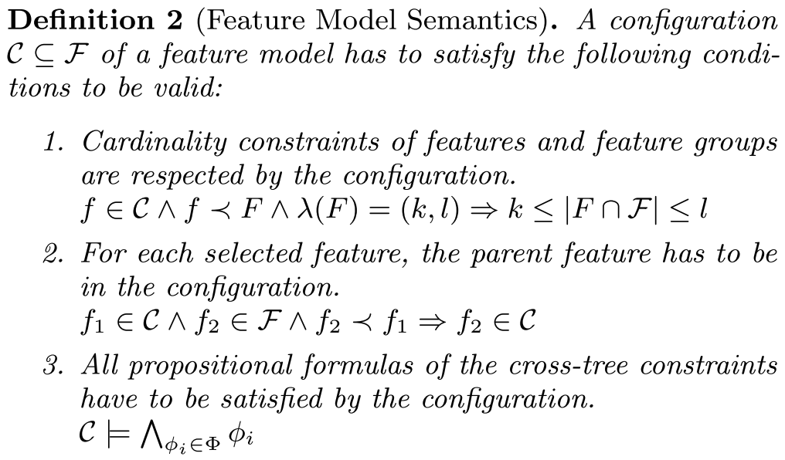
Definition 2: Feature Model Semantics
TurtleBot
Engine
Movement
Webservice
Detection
[1..1]
[1..3]
Keyboard
Gamepad
Autonomous
Bump
Infrared
Ultrasound
Cross-Tree Constraints
Autonomous → Detection
Keyboard ∨ Gamepad → Webservice
Notes:
Semantics of a feature model is the set of all valid configurations.

Slide 7
Problem: No Variability in Time in Feature Models
iRobot Create
iClebo Kobuki
TurtleBot
v1.0
v2.0
Evolution!
Evolution!
Engine
Movement
Webservice
Detection
[1..1]
[1..3]
Keyboard
Gamepad
Autonomous
Bump
Infrared
Ultrasound
Constraints caused by evolution (excerpt)
iClebo Kobuki is incompatible with TurtleBot v1.0
iClebo Kobuki requires at least TurtleBot v2.0
Problem
Feature model captures only variability in space
Only exactly one version of variable asset in feature model (no variability in time)
Notes:
Versions must be maintained for configuration, e.g., if not all customers upgrade to newest version (even more present in SECOs)

Slide 8
Requirements on Solution
Requirement 1 Support for feature versions as units of configuration.
Requirement 2 Specification of the relation of versions in logical development lines (i.e., predecessor and successor versions including branching).
Requirement 3 Expression of dependencies on and incompatibilities with version ranges.
Requirement 4 Support for users in selecting suitable combinations of versions from a selection of features.

Slide 9
Hyper Feature Models (HFMs)
Contribution 1

Slide 10
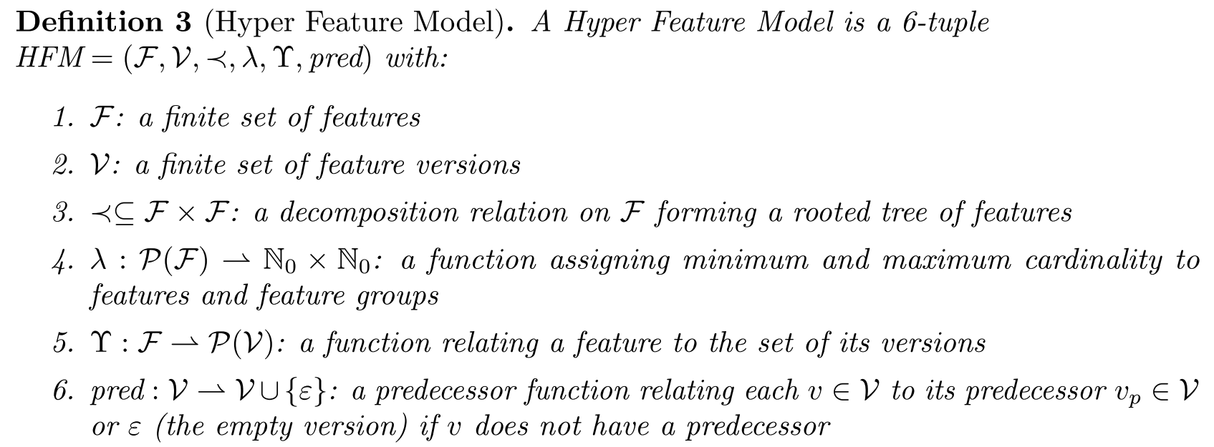
Definition 3: Hyper Feature Model (HFM)
TurtleBot
1.1
1.0
TurtleBot
Requirement 2b
2.0
2.1
Engine
Movement
Webservice
Detection
[1..1]
[1..3]
Keyboard
Gamepad
Autonomous
Bump
Infrared
Ultrasound
0.8
0.9
1.0
Requirement 1
Requirement 2a
Feature Model
(Definition 1)

Slide 11
Definition 5: HFM Semantics
TurtleBot
1.1
1.0
2.0
2.1
Engine
Movement
Webservice
Detection
Create 1.2
1.0
1.1
1.2
2.0
1.0
1.1
1.0
1.1
1.0
1.1
[1..1]
[1..3]
Kobuki 1.0
Keyboard
Gamepad
Autonomous
Bump
Infrared
Ultrasound
1.0
1.0
2.0
1.0
1.1
2.0
1.0
1.0
2.0
2.2
0.8
0.9
1.0

Slide 12
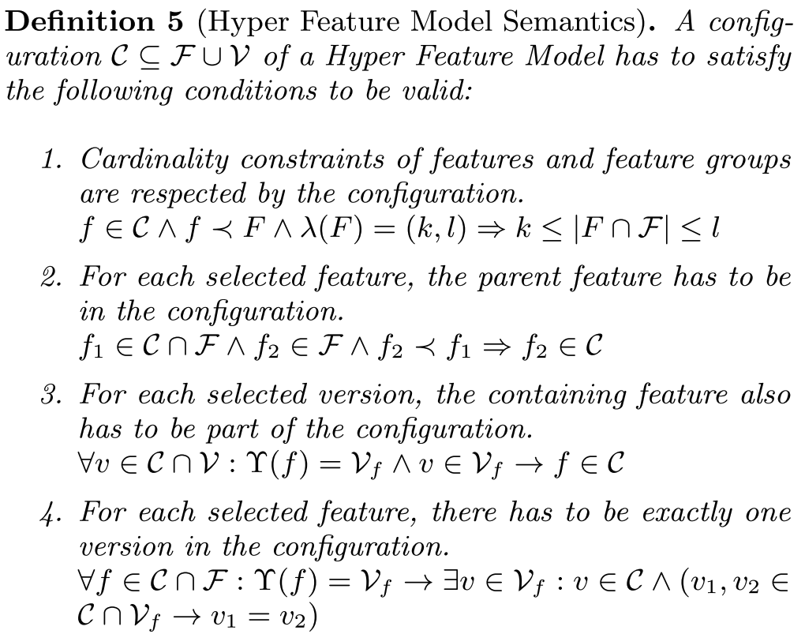
Definition 5: HFM Semantics
TurtleBot
1.1
1.0
2.0
2.1
Feature Model
(Definition 2)
Engine
Movement
Create 1.2
1.0
1.1
1.2
2.0
1.0
1.1
Kobuki 1.0
Keyboard
1.0
Notes:
Configuration contains features and feature versions.
Semantics of an HFM is the set of all valid configurations.

Slide 13
Version-Aware Constraint Language
Contribution 2

Slide 14
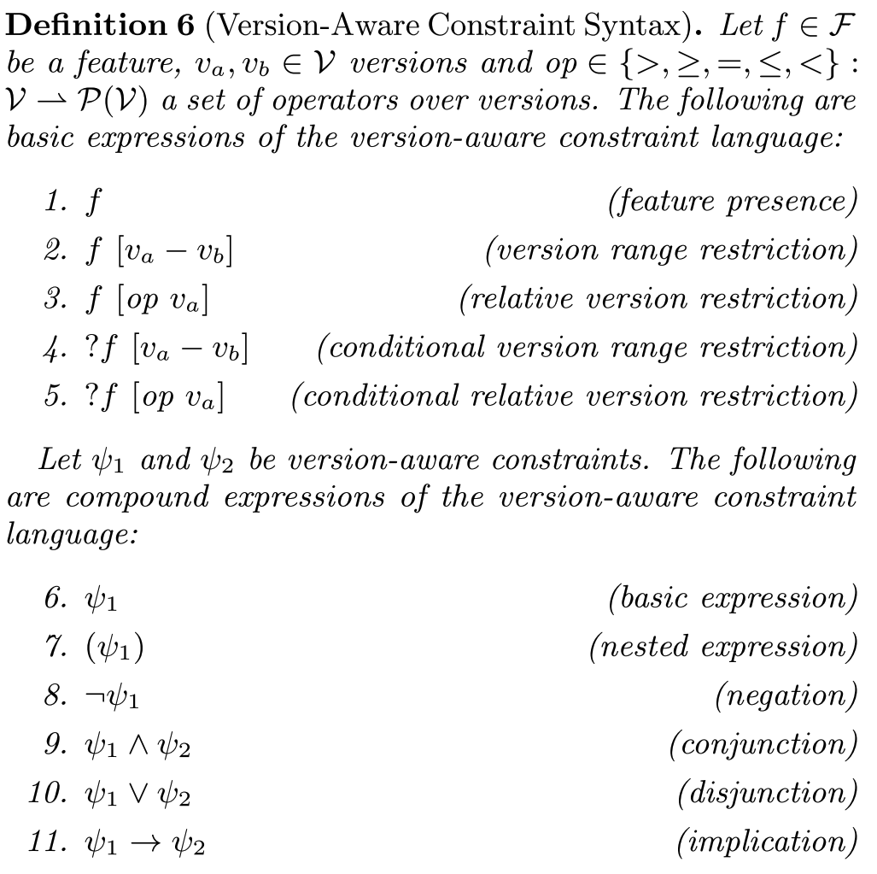
Definition 6: Version-Aware Constraint Syntax
Atomic Expressions
Requirement 3
Compound Expressions
Boolean Algebra

Slide 15
(Conditional) Version Range Restrictions
f [v_{a} – v_{b}]
?f [v_{a} – v_{b}] ≡ (f → f [v_{a} – v_{b}])
Examples
TurtleBot [1.0 – 1.1] → Engine [≤ Create 1.2]
?Movement [1.2 – 2.0]
Semantics
Usage
Closed intervals (fixed even if evolved)
E.g., dependencies of Eclipse manifest files
TurtleBot
TurtleBot [1.0 – 1.1]
1.1
1.0
2.0
2.1

Slide 16
(Conditional) Relative Version Restrictions
f [op v_{a}]
?f [op v_{a}] ≡ (f → f [op v_{a}])
Operators: op = {>, ≥, =, ≤, <}
Examples
TurtleBot [1.0 – 1.1] → Engine [≤ Create 1.2]
?Engine [≥ Kobuki 1.0]
Semantics
Usage
No need to know all versions in the interval explicitly
Open intervals (extended in case of evolution)
TurtleBot
TurtleBot [≤ 2.1]
1.1
1.0
2.0
2.1
Notes:
Deprecating old versions (example 2)

Slide 17
Automatic Version Selection
Contribution 3
Notes:
Manual version selection tedious because of incompatibilities.
Users (probably) only want to only select functionality and /usually) do not care about versions as long as they are plausbile (e.g., up-to-date and compatible).

Slide 18
Automatic Version Selection: General Procedure
Version-Aware Constraints
Autonomous → Detection
Keyboard ∨ Gamepad → Webservice
Infrared [≥ 2.0] ∨ Ultrasound → Detection [≥ 1.1]
TurtleBot [≥ 2.0] → Engine [≥ Kobuki 1.0]
TurtleBot [1.0 – 1.1] → Engine [≤ Create 1.2]
TurtleBot [≥ 2.0] → ?Webservice [≥ 1.1]
TurtleBot
1.0
1.1
2.0
2.1
+
Engine
Movement
Webservice
Detection
1.0
1.1
Create 1.2
1.0
1.1
1.2
2.0
1.0
1.1
1.0
1.1
Kobuki 1.0
[1..1]
[1..3]
Keyboard
Gamepad
Autonomous
Bump
Infrared
Ultrasound
encode
1.0
1.0
2.0
1.0
1.1
2.0
1.0
1.0
2.0
2.2
0.8
0.9
1.0
Constraint Satisfaction Problem (CSP) Solver
solve
All Possible (Version) Configurations
select
Scoring to find "best" configuration
TurtleBot
1.0
1.1
2.0
2.1
Engine
Movement
Webservice
Detection
1.0
1.1
Create 1.2
1.0
1.1
1.2
2.0
1.0
1.1
1.0
1.1
Kobuki 1.0
[1..1]
[1..3]
Keyboard
Gamepad
Autonomous
Bump
Infrared
Ultrasound
1.0
1.0
2.0
1.0
1.1
2.0
1.0
1.0
2.0
2.2
0.8
0.9
1.0
Notes:
encode: easy due to previous formulation as set theory
Pre-configuration also allows selection of versions.

Slide 19
Scoring to Find "Best" Configuration
TurtleBot
importance(v) = 1/(0 + 1) = 1.0
novelty(v) = 1/(1 + 1) = 0.5
score(v) = i(v) * n(v) = 0.5
i(v) = 1/(0 + 1) = 1.0
n(v) = 1/(0 + 1) = 1.0
s(v) = i(v) * n(v) = 1.0
Requirement 4
i(v) = 1/(0 + 1) = 1.0
n(v) = 1/(0 + 1) = 1.0
s(v) = i(v) * n(v) = 1.0
i(v) = 1/(1 + 1) = 0.5
n(v) = 1/(0 + 1) = 1.0
s(v) = i(v) * n(v) = 0.5
i(v) = 1/(1 + 1) = 0.5
n(v) = 1/(0 + 1) = 1.0
s(v) = i(v) * n(v) = 0.5
1.1
1.0
TurtleBot [≥ 2.0] → Engine [≥ Kobuki 1.0]
2.0
2.1
Engine
Movement
Webservice
Detection
Create 1.2
1.0
1.1
1.2
2.0
1.0
1.1
1.0
1.1
1.0
1.1
[1..1]
[1..3]
Kobuki 1.0
Keyboard
Gamepad
Autonomous
Bump
Infrared
Ultrasound
1.0
1.0
2.0
1.0
1.1
2.0
1.0
1.0
2.0
2.2
0.8
0.9
1.0
Notes:
Importance:
Features closer to the root feature in the tree are considered to have a larger effect
Depth of feature containing v in the feature model
Novelty:
Versions toward the end of a branch are considered more up-to-date
Length of shortest path from v to a version without successor on the same development line
Final two configurations have same score - both are valid and equally „good“.
One is selected arbitrarily (user may influence choice by pre-selecting versions).
All requirements fulfilled -> solution -> conclusion.

Slide 20
Conclusion
Problem: No variability in time in Feature Models
Solution
Hyper Feature Models (HFMs)
Version-Aware Constraint Language
Automatic Version Selection
Fulfills initially posed requirements
Evaluated in case study using TurtleBot driver
Capturing variability in space and time in Hyper Feature Models

Slide 21
Questions, Comments, Feedback?
Thank you for your attention!

